Slide 1
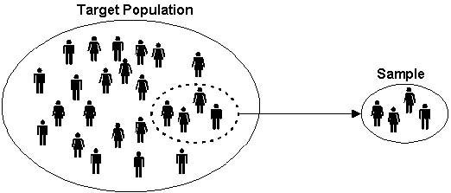
Sampling Methods II
By: Hossein

Slide 2
Want to know about:
Average age of UWO students (2016)
Average annual income of Canadians in 2016
Average height of all Canadian students (2016)

Slide 3
Probability sampling is some form of random selection in choosing the elements. This type of sampling involves a selection process in which each element in the population has an equal and independent chance of being selected.
Non-probability sampling: the elements that make up the sample, are selected by nonrandom methods (because of limitations in time, money, workforce, etc.)

Slide 4
Probability sampling Techniques:
Simple random sampling
Stratified random sampling
Cluster sampling
Systematic sampling

Slide 5
Non Probability sampling:
Convenience sampling is that the samples are selected because they are accessible to the researcher. Subjects are chosen simply because they are easy to recruit. This technique is considered easiest, cheapest and least time consuming.
Average age of UWO students (2016)

Slide 6
Non Probability sampling:
Consecutive sampling is very similar to convenience sampling except that it seeks to include ALL accessible subjects as part of the sample.
Average age of UWO students in Science (2016)

Slide 7
Non Probability sampling:
Quota sampling: the researcher ensures equal or proportionate representation of subjects depending on which trait is considered as basis of the quota.
This is usually for age, gender, education, race, religion and socioeconomic status.
Average age of UWO students for each genders (2016)

Slide 8
Non Probability sampling:
Judgmental (purposive) sampling: In this type of sampling, subjects are chosen to be part of the sample with a specific purpose in mind.
With judgmental sampling, the researcher believes that some subjects are more fit for the research compared to other individuals.
Average age of 3rd year UWO students (2016)

Slide 9
Non Probability sampling:
Snowball sampling is usually done when there is a very small population size, where the researcher asks the initial subject to identify another potential subject who also meets the criteria of the research. The downside of using a snowball sample is that it is hardly representative of the population.
Average age of UWO STATISTICS students (2016)

Slide 10
summary
Probability sampling:
Simple random sampling
Stratified random sampling
Cluster sampling
Systematic sampling
Non Probability sampling:
Convenience Sampling
Consecutive Sampling
Quota Sampling
Judgmental Sampling
Snowball Sampling

Slide 11
Thanks!

